Slide 1

Bioinformatics tools to study protein-protein and protein-ligand interactions
Course on Protein Networks and
Systems Biology (Bologna, 14-18 December 2015)
Speaker: Luana Licata, MINT, University of Rome Tor Vergata

Slide 2
Course on Protein Networks and Systems Biology
Session Outline
Introduction to Protein-Protein Interactions (PPIs)
What are PPIs
Why it is important to study PPIs
PPI databases
IMEx database
IntAct website
Data structure and curation models

Slide 3
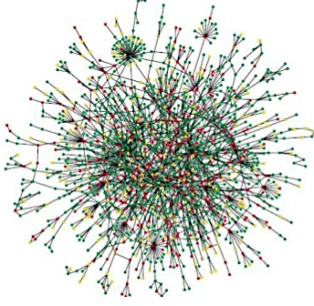
Course on Protein Networks and Systems Biology
SYSTEM BIOLOGY
SYSTEM BIOLOGY IS A DISCIPLINE THAT APPLIES AN HOLISTIC
APPROACH TO UNDERSTAND COMPLEXITY IN BIOLOGY BY
INTEGRATING MANY SCIENTIFIC DISCIPLINES – BIOLOGY,
COMPUTER SCIENCE, BIOINFORMATICS, PHYSICS AND OTHERS
A COMPLEX SYSTEM IS A SYSTEM MADE BY MANY INTERACTING
COMPONENTS, SUCH FOR EXAMPLE PROTEINS
TO STUDY THE INTERACTIONS BETWEEN THE COMPONENTS OF BIOLOGICAL SYSTEMS,
GIVE RISE TO THE FUNCTION AND BEHAVIOR OF THAT SYSTEM

Slide 4
Course on Protein Networks and Systems Biology
Protein-Protein Interactions (PPI)
Protein–protein interactions are physical contacts formed by biochemical events and/or electrostatic forces between two or more proteins.
PPIs can occur only in a specific biological context and between specific molecular region
Proteins rarely act alone. Many molecular processes within a cell are carried out by molecular machines that are built from a large number of interacting proteins organized as complex.
Protein-protein interaction networks, called INTERACTOME provide information about the organization of a cell. Interactome models can be used to predicte poorly characterized proteins into their functional contest.
Knowing whether two proteins interact can hels us discovering unknown protein function.
If the function of one protein is known, the function of its binding partners is likely to be related, “guilty by association”.

Slide 5
Course on Protein Networks and Systems Biology
Principal methods for detecting protein-protein interactions
Wide variety of techniques and methods have been developed to generate PPI data and can be subdivided in:
High throughput techniques
Low throughput techniques
These techniques can be further divided in:
techniques that detect direct physical interactions between two proteins, called binary methods
techniques that detect interactions among groups of proteins that may not form physical contacts — co-complex methods.

Slide 6
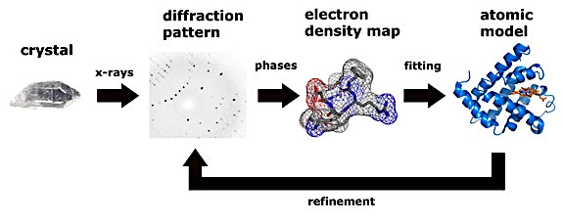
Course on Protein Networks and Systems Biology
Principal methods for detecting protein-protein interactions
Some low throughput techniques provide deeper insight certain characteristic of an interaction, such as FRET, spr, itc, nmr and X-ray crystallography.
X-ray crystallography is considered the gold standard for PPI, since provide high quality data of binding surfaces to the level of individual atoms and binding sites.
From Thomas Splettstoesser (www.scistyle.com)

Slide 7
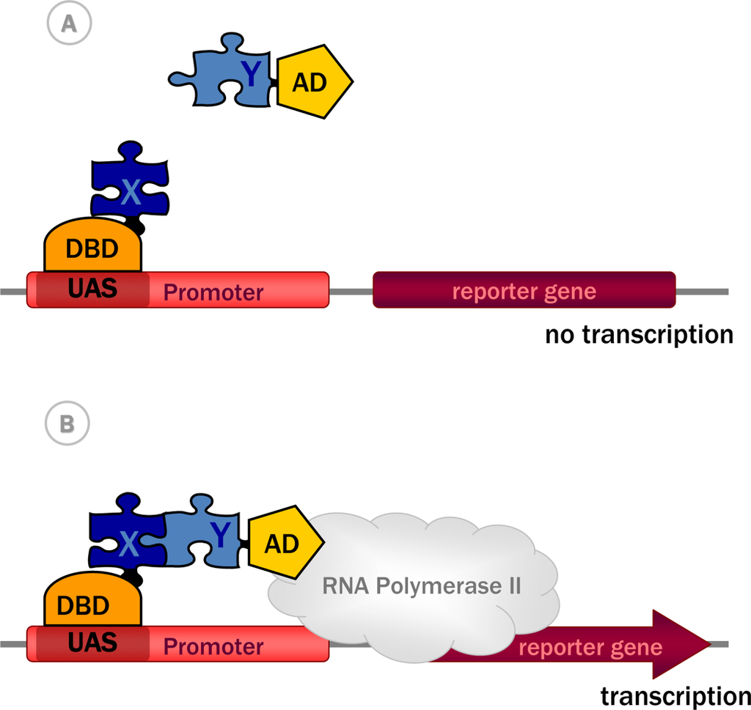
Course on Protein Networks and Systems Biology
Principal methods for detecting protein-protein interactions
The main binary methods for measuring of direct physical interactions between protein pairs is Yeast two-hybrid (Y2H)-The strategy interrogates two proteins, called bait and prey, coupled to two halves of a transcription factor and expressed in yeast. If the proteins make contact, they reconstitute a transcription factor that activates a reporter gene.
From Yeast Two-Hybrid, a Powerful Tool for Systems Biology, Anna Brückner , Cécile Polge, Nicolas Lentze, Daniel Auerbach and Uwe Schlattner, Int. J. Mol. Sci. 2009

Slide 8
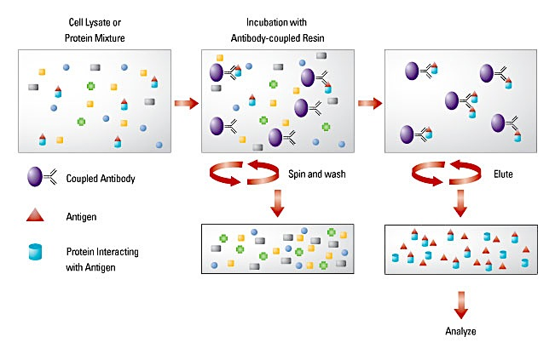
Course on Protein Networks and Systems Biology
Principal methods for detecting protein-protein interactions
The most common co-complex method is co-immunoprecipitation (co-IP) coupled with mass spectrometry (MS). In this approach, the bait protein, usually expressed in the cell at in vivo conditions, is affinity purified and the interacting partners are detected by mass spectrometry.

Slide 9






Course on Protein Networks and Systems Biology
Curation and Databases
Wet Lab Scientists
Scientific Curators
Molecular Interaction
DataBases

Slide 10
Course on Protein Networks and Systems Biology
Molecular Interaction Databases
Molecular interaction databases have been established to archive and subsequently disseminate molecular interaction data in a structured format available to perform searches and bioinformatics analyses.
Molecular interaction databases can be divided in:
Primary databases: experimentally proven protein interactions coming from either small-scale or large-scale published studies that have been manually curated
Meta databases: experimentally proven PPIs obtained by consistent integration of several primary databases
Prediction databases: mainly predicted PPIs derived using different approaches, combined with experimentally proven PPIs.

Slide 11
PPI databases categorization and qualifications
Course on Protein Networks and Systems Biology
Type of data captured:
Only PPIs information as MINT and DIP.
Interactions between proteins and other molecular types (DNA, RNA, small molecules)
as IntAct and MatrixDB.
PPIs and genetic interactions as BIOGRID.
Only PPIs related to a specific scientific topic such as : InnateDB (PPIs in the immune system),
MPIDB (PPIs in microbes) and MatrixDB (extracellular PPIs).
Type of curation Policy:
Databases describing PPIs with low level of curation details and quality control procedures
Databases describing PPIs with high level of curation details and high accuracy of quality
control procedures such as IMEx databases.

Slide 12
Course on Protein Networks and Systems Biology
Principal Molecular Interaction Databases
A fuller list of molecular
interaction databases is
available at:
http://www.pathguide.org.
Luana Licata and Sandra Orchard, The MIntAct Project and Molecular Interaction Databases,
Methods in Molecular Biology Chapter, Springer, in press.

Slide 13
Course on Protein Networks and Systems Biology
IMEx Consortium
An international collaboration between a group of major public interaction data providers who have agreed to share curation effort (www.imexconsortium.org)
12 active molecular interaction databases dedicated to producing high quality, annotated data, curated to the same standards and following the same curation rules
Data is curated once at a single centre then exchanged between partners
Users need only go to a single site to obtain all data
Imex Central
The web service IMEx Central (https://imexcentral.org/icentralbeta/) is a central resource to assign IMEx IDs to the publications curated by IMEx members (version BETA-0.93 has been recently released).
Curators can check by using the NCBI PubMed identifier (PMID) if other IMEx members have curated an already published paper and therefore it allows avoiding work duplication.

Slide 14
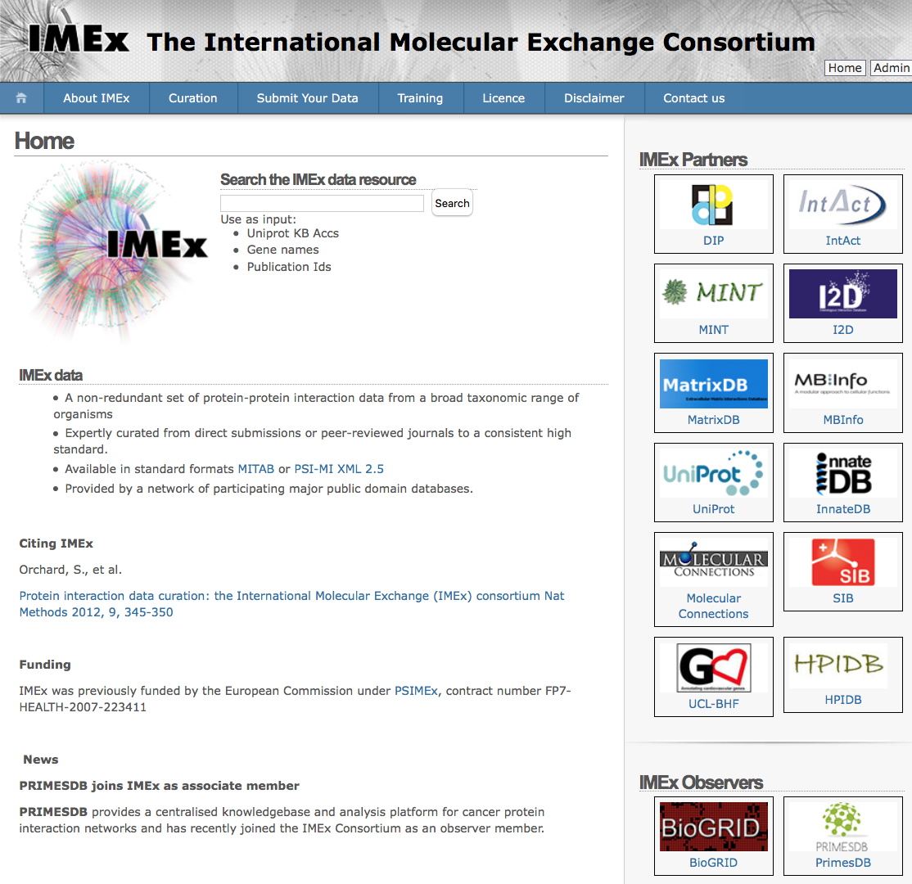
Course on Protein Networks and Systems Biology
IMEx Consortium

Slide 15
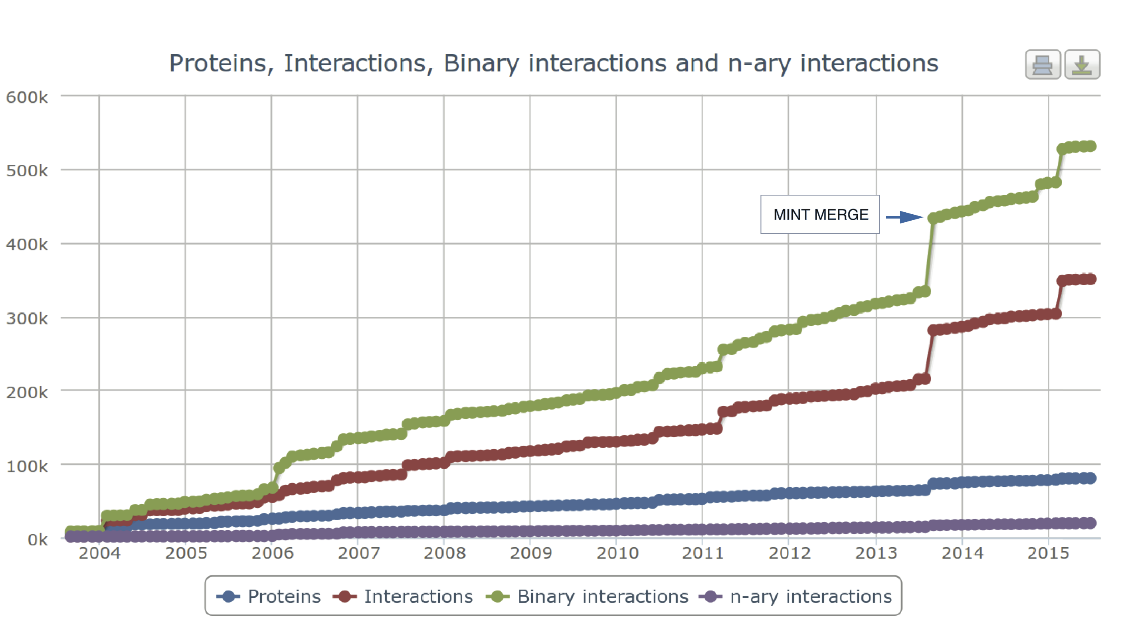
Course on Protein Networks and Systems Biology
MintAct Project
MINT and IntAct databases were two of the largest databases (number of manuscripts curated and the number of non-redundant interactions).
Both adopted the highest possible data quality standards.
Both were founder members of the IMEx Consortium.
IntAct and MINT joined forces to create a single resource to improve curation and software development efforts.
Data maintenance, and the PSICQUIC and IMEx web services are the responsibility of the IntAct team, while the curation effort is undertaken by both IntAct and MINT curators.

Slide 16
Course on Protein Networks and Systems Biology
MINTAct goals & achievements
Freely available open-source database of
molecular interactions (mainly PPIs).
~560K binary interactions taken
from >13892 publications (November 2015).
Data is standards-compliant and available via IntAct website, for download at the ftp site or via PSICQUIC:
http://www.ebi.ac.uk/intact
ftp://ftp.ebi.ac.uk/pub/databases/intact
www.ebi.ac.uk/Tools/webservices/psicquic/view/main.xhtml

Slide 17
Course on Protein Networks and Systems Biology
An inside look to a molecular interaction database
How to search a molecular interaction database
Which information it possible to retrieve
Which kind of data contains
How it possible to download data
How to visualize data

Slide 18
Course on Protein Networks and Systems Biology
Representing PPIs: Interacting Domains
The way to represent binding domain
of interacting proteins in IMEx databases
Prot A
Prot B
Prot C
Prot A
Prot B
Prot C

Slide 19
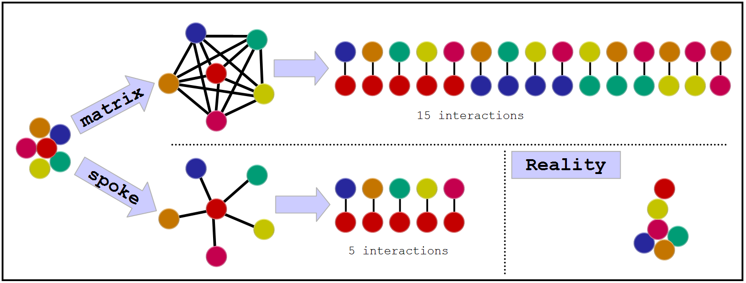
Course on Protein Networks and Systems Biology
Complex representation
Several experimental techniques produce complex data: Eg. co-IP coupled with MS
There are two algorithms available to convert complexes into binary interactions
http://www.ebi.ac.uk

Slide 20
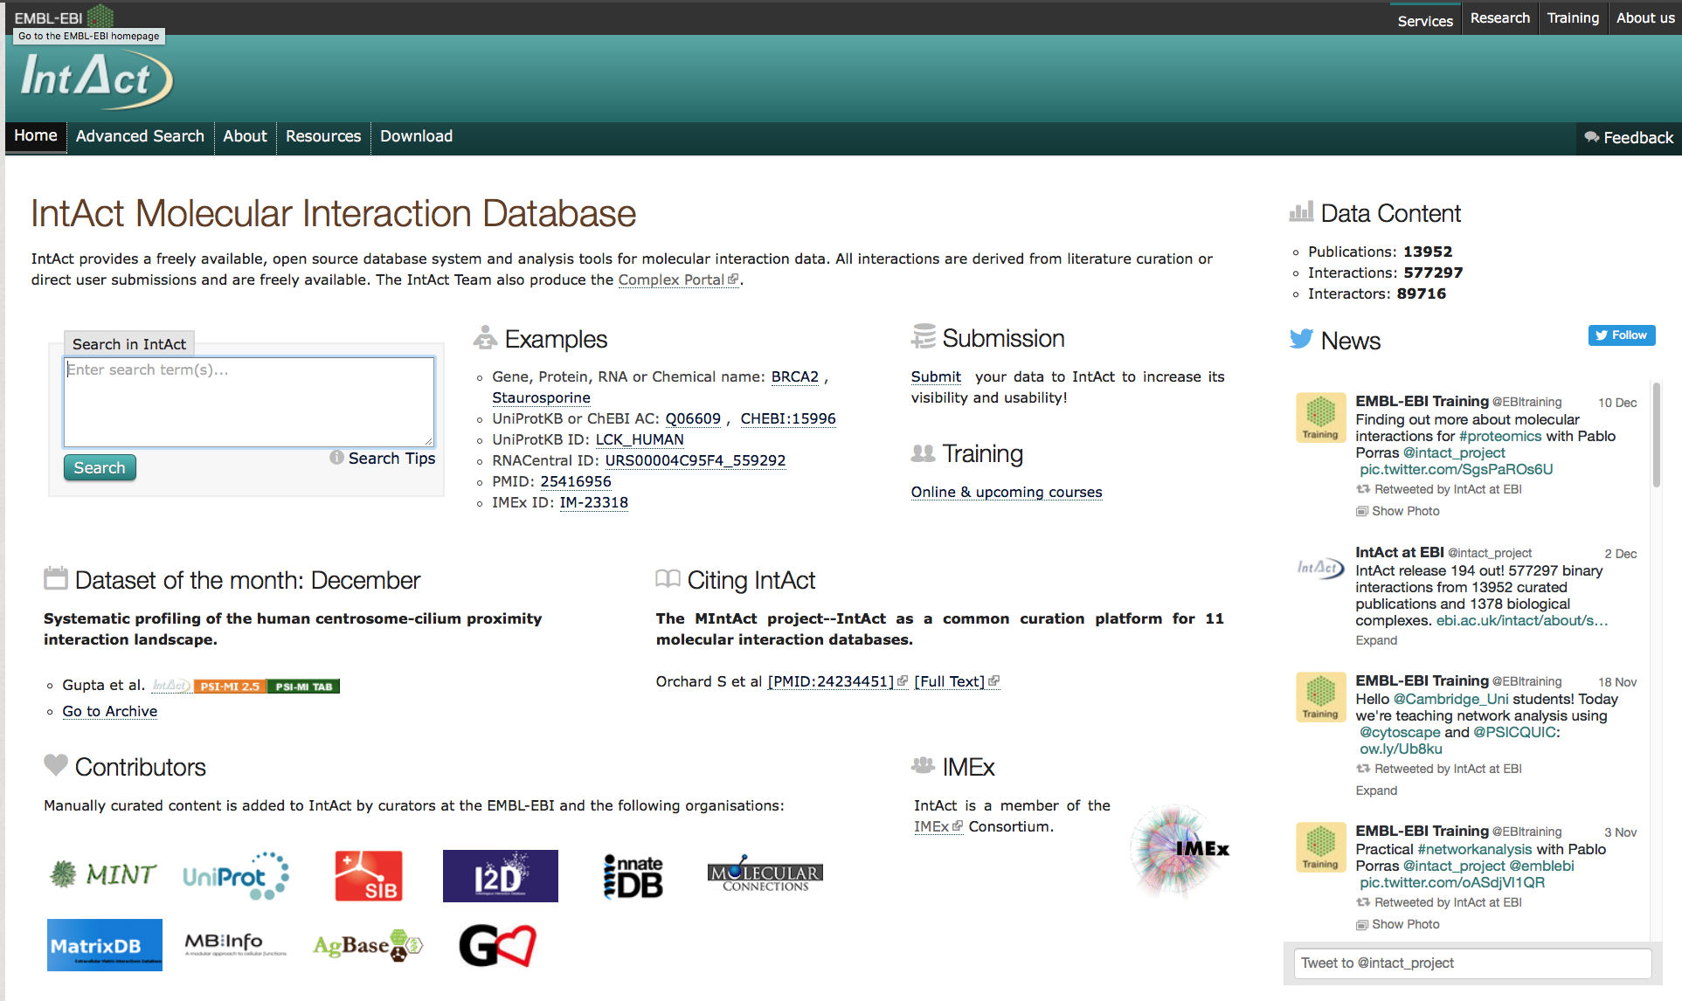
Course on Protein Networks and Systems Biology
The IntAct database
IntAct Home Page (http://www.ebi.ac.uk/intact/)
Creb1

Slide 21
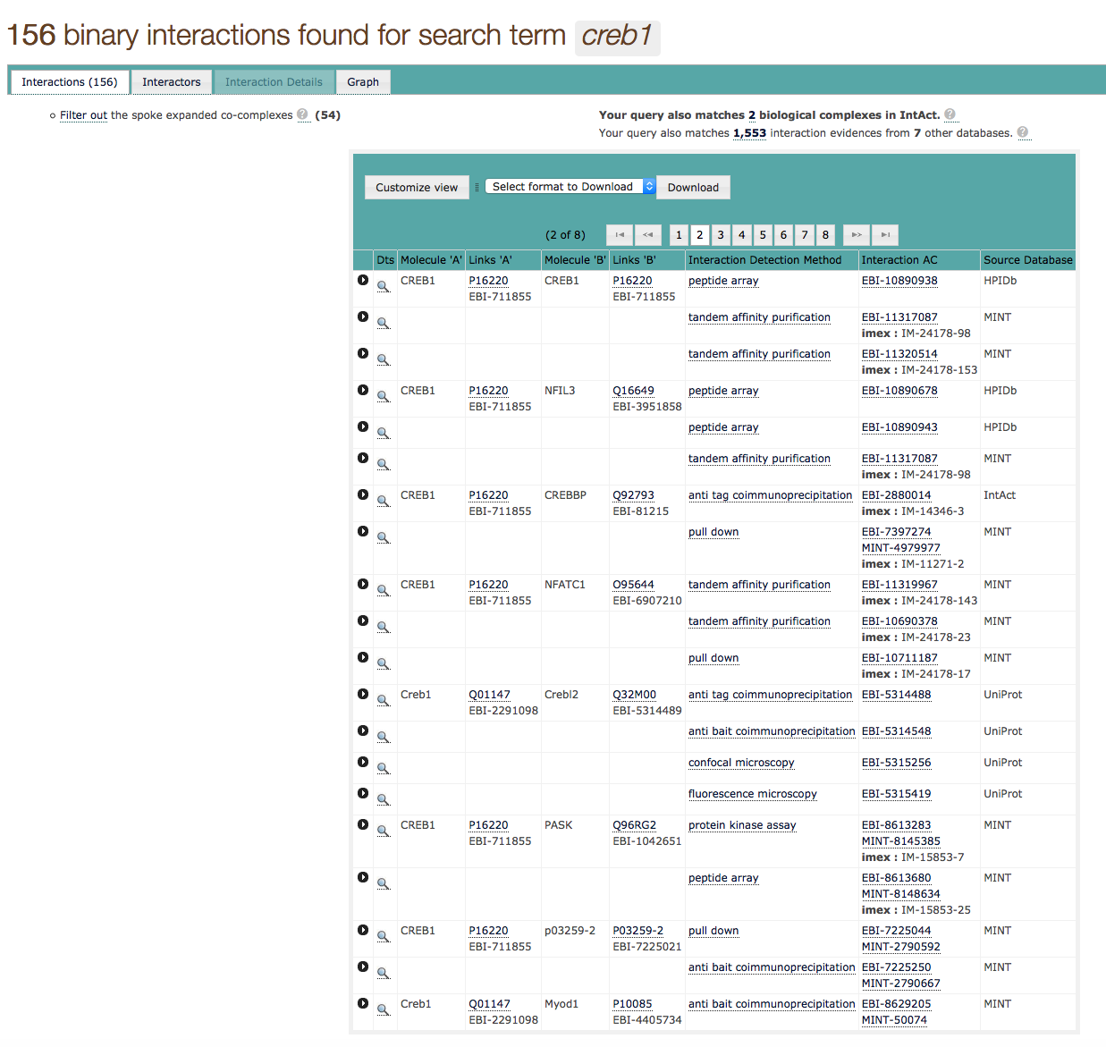
Course on Protein Networks and Systems Biology
The IntAct database: Result page

Slide 22
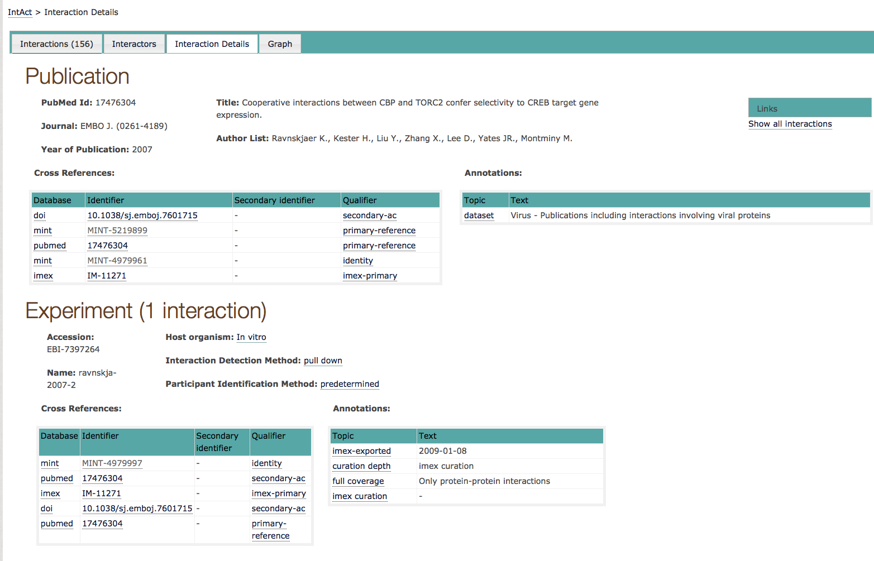
Course on Protein Networks and Systems Biology
The IntAct database: Interaction details

Slide 23
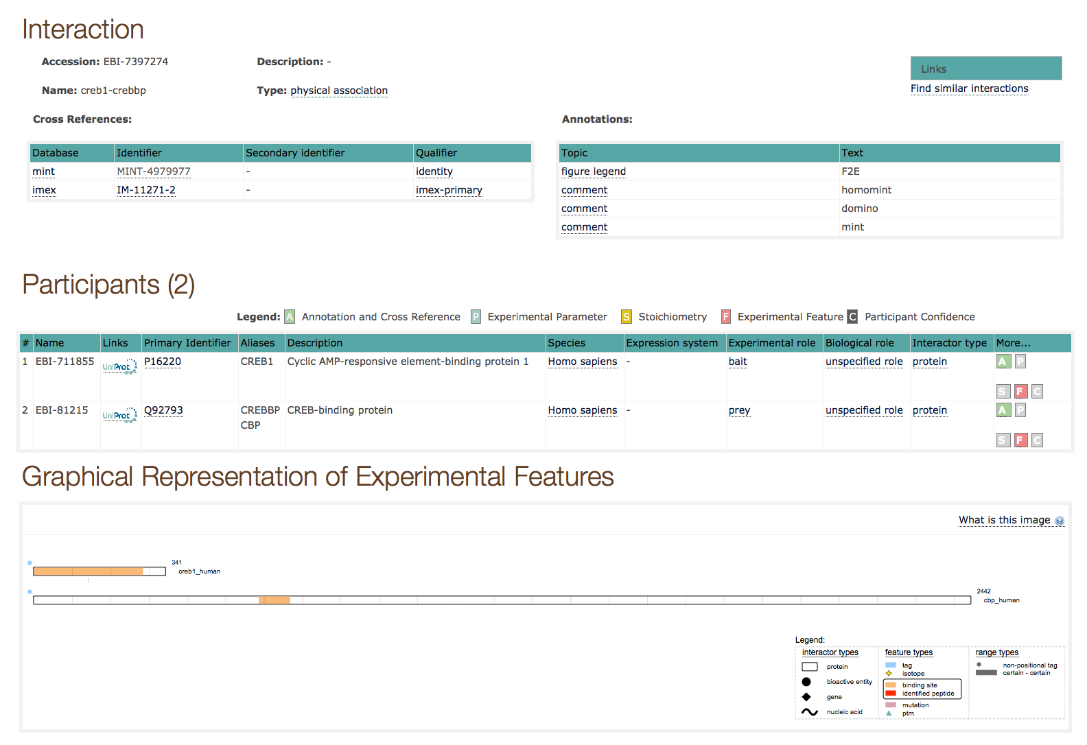
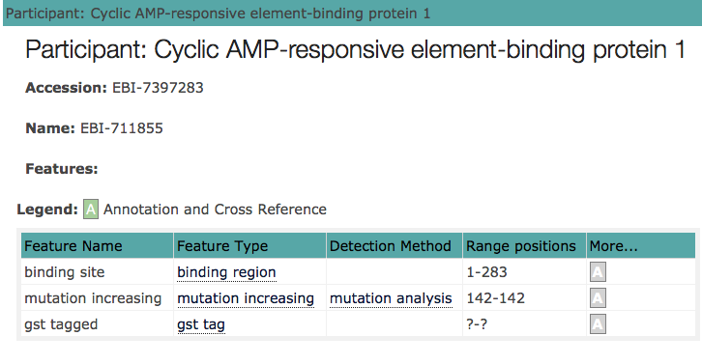
Course on Protein Networks and Systems Biology
The IntAct database: Interaction details

Slide 24
Course on Protein Networks and Systems Biology
The IntAct database: Network visualisation
Network visualisation of the interactions present in a specific paper

Slide 25
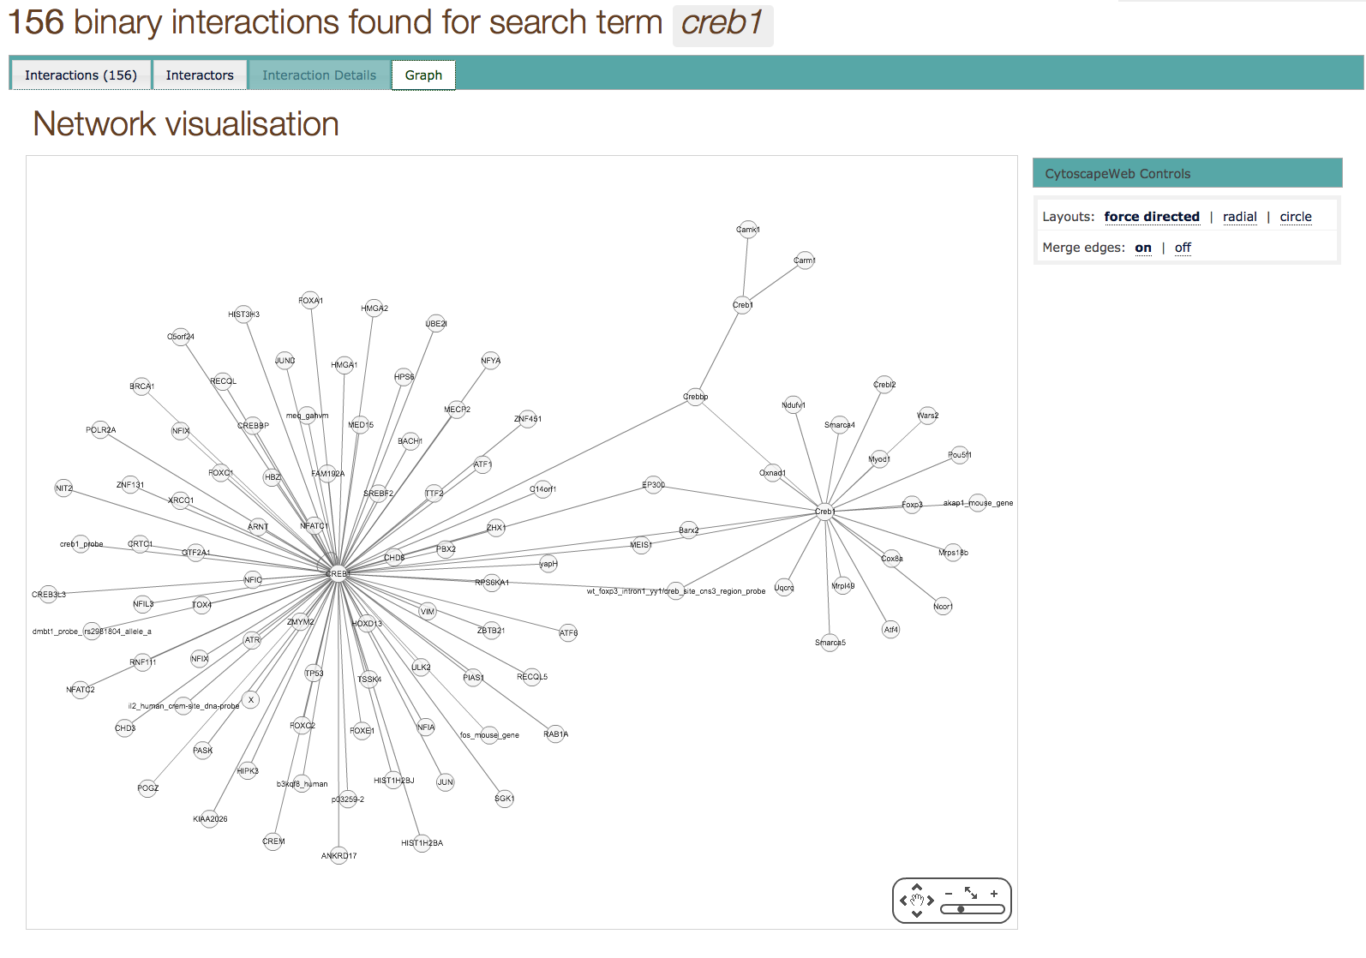
Course on Protein Networks and Systems Biology
The IntAct database
Network visualisation of all the “Creb1” interactions present in the database

Slide 26

Course on Protein Networks and Systems Biology
Questions???

Slide 27
Course on Protein Networks and Systems Biology
Practical 1: Protein-Protein Interactions and Bioinformatics tools
Go to: sites.google.com/site/peppeprofiti/resources
Training session: Searching IntAct database
In this training session you will use IntAct database.
perform different search
check the number of interaction evidences
look for the experimental details
download data using different formats.
Step1: Quick Search
Step2: Refining a search using the Advanced Search
Step3: Download data

Slide 28
Course on Protein Networks and Systems Biology
References
Kerrien S, Aranda B, Breuza L, Bridge A, Broackes-Carter F, Chen C, Duesbury M, Dumousseau M, Feuermann M, Hinz U, Jandrasits C, Jimenez RC, Khadake J, Mahadevan U, Masson P, Pedruzzi I, Pfeiffenberger E, Porras P, Raghunath A, Roechert B, Orchard S, Hermjakob H (2012) The IntAct molecular interaction database in 2012. Nucleic Acids Res 40:D841–6. doi: 10.1093/nar/gkr1088
Licata L, Briganti L, Peluso D, Perfetto L, Iannuccelli M, Galeota E, Sacco F, Palma A, Nardozza AP, Santonico E, Castagnoli L, Cesareni G (2012) MINT, the molecular interaction database: 2012 update. Nucleic Acids Res 40:D857–61. doi: 10.1093/nar/gkr930
Orchard S, Ammari M, Aranda B, Breuza L, Briganti L, Broackes-Carter F, Campbell NH, Chavali G, Chen C, del-Toro N, Duesbury M, Dumousseau M, Galeota E, Hinz U, Iannuccelli M, Jagannathan S, Jimenez R, Khadake J, Lagreid A, Licata L, Lovering RC, Meldal B, Melidoni AN, Milagros M, Peluso D, Perfetto L, Porras P, Raghunath A, Ricard-Blum S, Roechert B, Stutz A, Tognolli M, van Roey K, Cesareni G, Hermjakob H (2014) The MIntAct project--IntAct as a common curation platform for 11 molecular interaction databases. Nucleic Acids Res 42:D358–63. doi: 10.1093/nar/gkt1115
Orchard S, Salwinski L, Kerrien S, Montecchi-Palazzi L, Oesterheld M, Stümpflen V, Ceol A, Chatr-aryamontri A, Armstrong J, Woollard P, Salama JJ, Moore S, Wojcik J, Bader GD, Vidal M, Cusick ME, Gerstein M, Gavin A-C, Superti-Furga G, Greenblatt J, Bader J, Uetz P, Tyers M, Legrain P, Fields S, Mulder N, Gilson M, Niepmann M, Burgoon L, De Las Rivas J, Prieto C, Perreau VM, Hogue C, Mewes H-W, Apweiler R, Xenarios I, Eisenberg D, Cesareni G, Hermjakob H (2007) The minimum information required for reporting a molecular interaction experiment (MIMIx). Nat Biotechnol 25:894–8. doi: 10.1038/nbt1324
Koh GC, Porras P, Aranda B, Hermjakob H, Orchard SE., Analyzing protein-protein interaction networks. J Proteome Res. 2012 Apr 6;11(4):2014-31. doi: 10.1021/pr201211w. Epub 2012 Mar 2. Review.
Orchard S., Molecular interaction databases. Proteomics. 2012 May;12(10):1656-62. doi: 10.1002/pmic.201100484. Review.

